Slide 1

Characterization of asbestos minerals in serpentinites quarries in the Pollino Massif (Southern Apennines, Italy)
Roberto Buccione ¹, Giovanna Rizzo ¹, Michele Paternoster ¹, Giovanni Mongelli ¹, and Angela De Bonis ¹
Department of Sciences, University of Basilicata
Institute of Methodologies for Environmental Analysis (IMAA), National Research Council (CNR)

Slide 2
Introduction
The presented study focuses on several natural, serpentinite outcrops in the low-grade metamorphic ophiolites of the Pollino massif (Calabria-Lucania boundary, Southern Italy)
It is very important to find an analytical tool of environmental control useful for the identification of the asbestos minerals
These rocks were used as pilot samples for the identification of asbestiform minerals using μ-Raman spectroscopy and X-ray powder diffraction (XRPD) analysis.
Furthermore, we compared the used analytical procedures, to assess the better and safer method for the study and the identification of health dangerous materials.

Slide 3
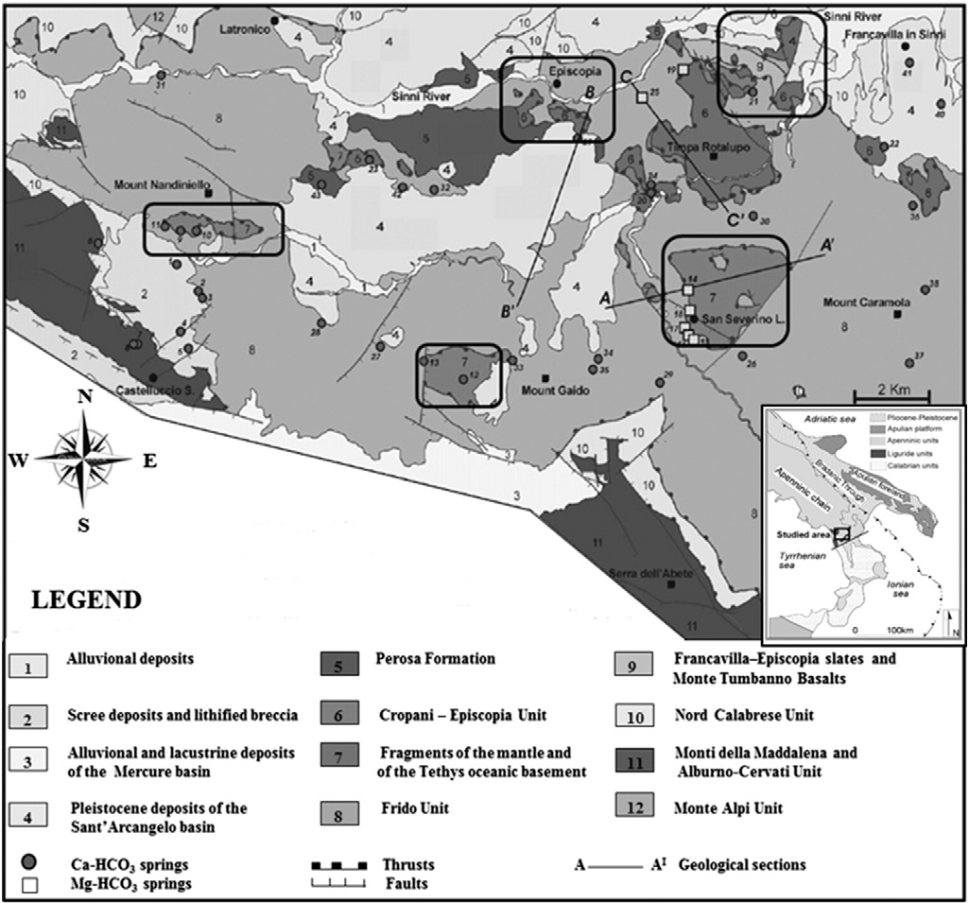
Geological settings and ophiolites occurrence
The studied area (Pollino massif) derived from the deformation of the African passive margin occurred between the Oligocene and Pleistocene.
This work focused on serpentinites rocks that derive from serpentinization of mantle peridotites (Sansone et al., 2012a,b), upper mantle basement of the Internal Liguride sequence (Frido Unit) consisting of Neotethyan Ocean fragments uplifted during formation of the Apennine belt.

Slide 4
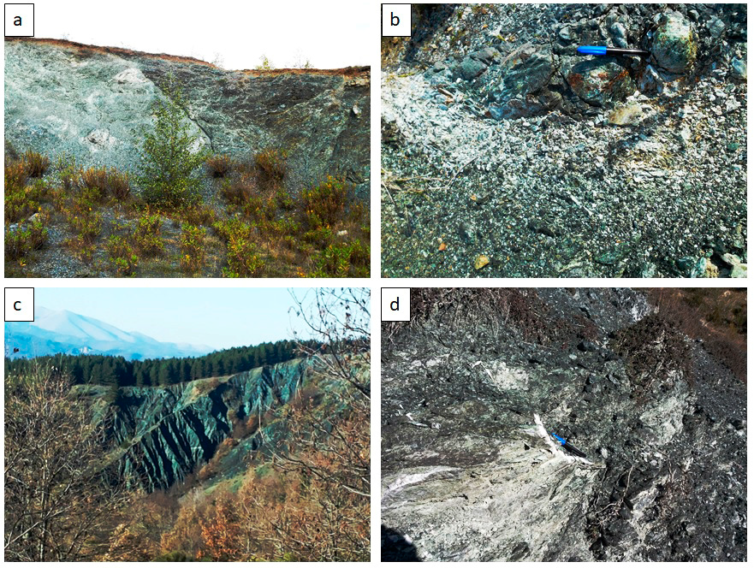
Sampling activity
Fagosa quarry
Nandiniello quarry
Fosso Arcangelo
San Severino Lucano

Slide 5
Analytical techniques
Analysis were performed on Thirteen samples of serpentinite rocks from the Frido Unit (Northern Calabria)
Petrographic characterization were conducted with optical microscopy on thin section of rock samples.
XRPD analysis were performed on randomly oriented powdered samples of both bulk rocks and vein infill.
Raman spectroscopy analyses were performed on 3 × 2 × 0.4 cm rock slabs obtained by a cutting machine

Slide 6
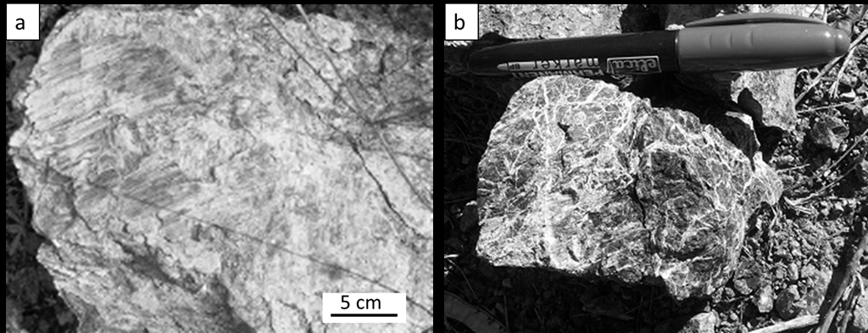
The asbestos-rich lithologies
Centimetre fibers developed over slickenside surfaces
(sample from Fagosa quarry).
Very fine-grained fibers along a fracture network pervading the full rock
(sample from San Severino Lucano)

Slide 7
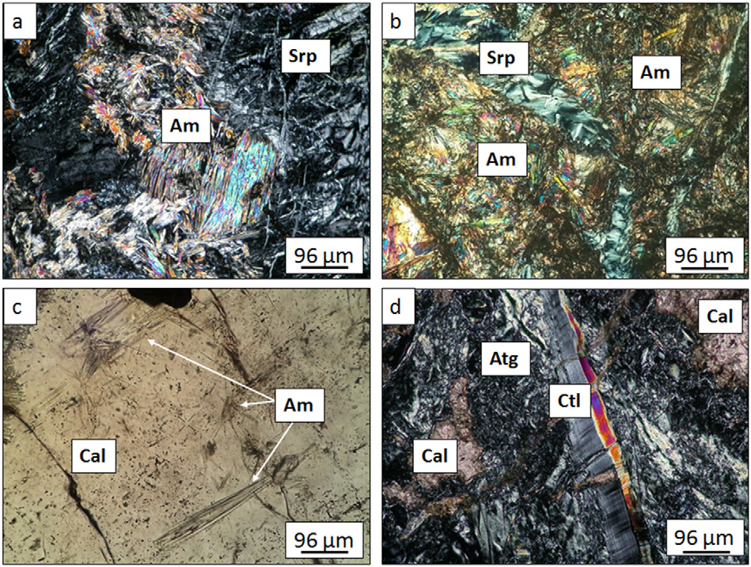
Petrography
Amphibole minerals in the matrix
of the serpentinite rocks
vein filled by serpentine+amphiboles
veins filled by calcite+amphiboles
chrysotile vein in the antigorite matrix

Slide 8
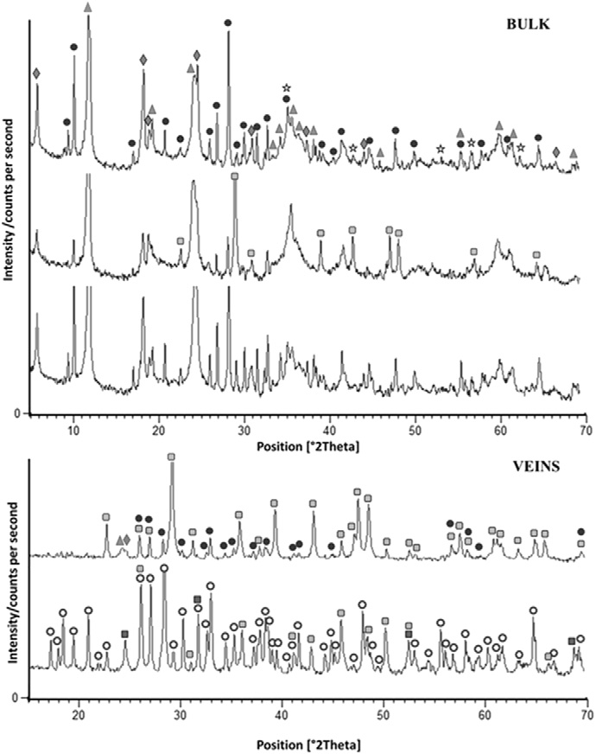
XRPD assessment
XRPD analysis on bulk powder allowed the recognition of the following minerals:
Serpentine and amphibole-like minerals (actinolite and tremolite) are the dominant phases;
Phyllosilicate (clinochlore), with minor amount of iron oxides (magnetite);
Calcite, Aragonite, and Dolomite are also present.
= serpentine
= tremolite
= actinolite
= clinochlore
= calcite
= aragonite
= rhodochrosite
= magnetite

Slide 9
XRPD assessment
The diffraction patterns of veins show that amphiboles (actinolite, tremolite), and carbonate minerals are the main components.
Calcite and aragonite are also present
XRPD analysis does not allow accurately the identification of different serpentine polytypes, because the position of the main diffraction peaks, is very similar.
= serpentine
= tremolite
= actinolite
= clinochlore
= calcite
= aragonite
= rhodochrosite
= magnetite

Slide 10
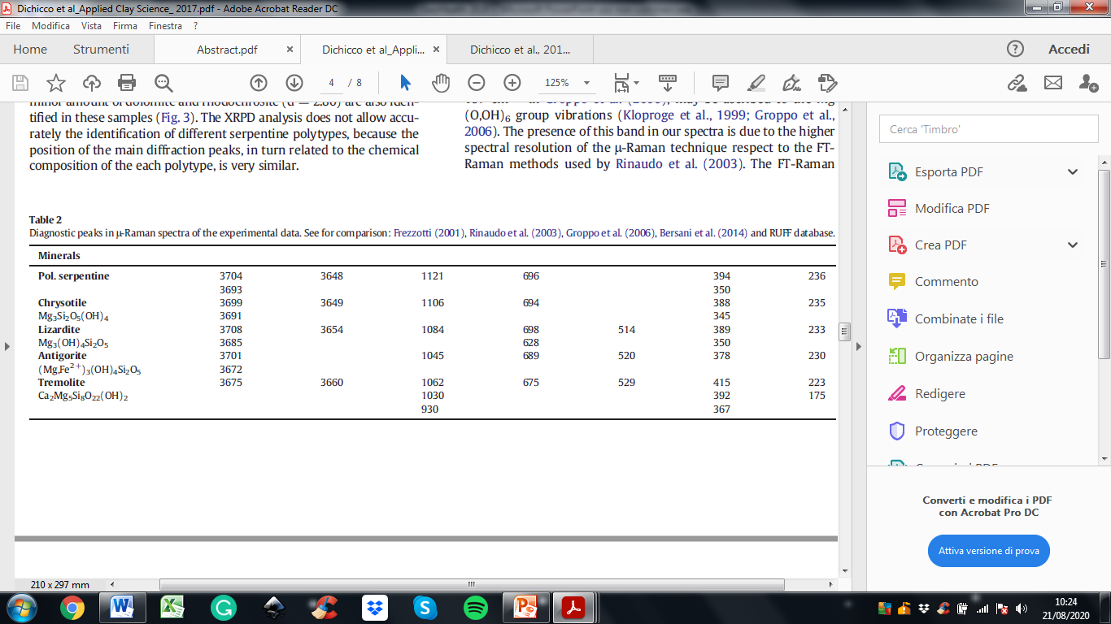
μ-Raman spectroscopy
μ-Raman measurements were performed to further identify minerals that compose analysed serpentinite rocks.
This technique is particularly valuable for a quick and reliable identification of serpentine minerals (lizardite, antigorite, chrysotile and polygonal serpentine), as well as amphibole polymorphs (tremolite and ferro-actinolite).
The results show that lizardite and chrysotile are the dominants serpentine phases.

Slide 11
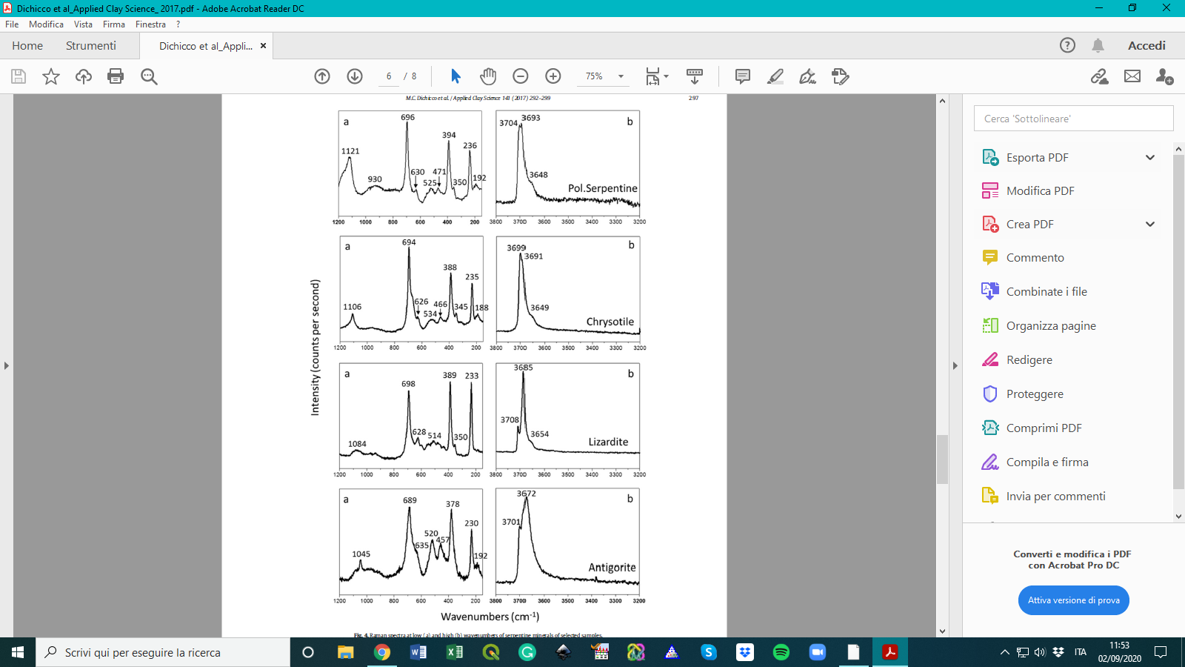
μ-Raman spectroscopy

Slide 12
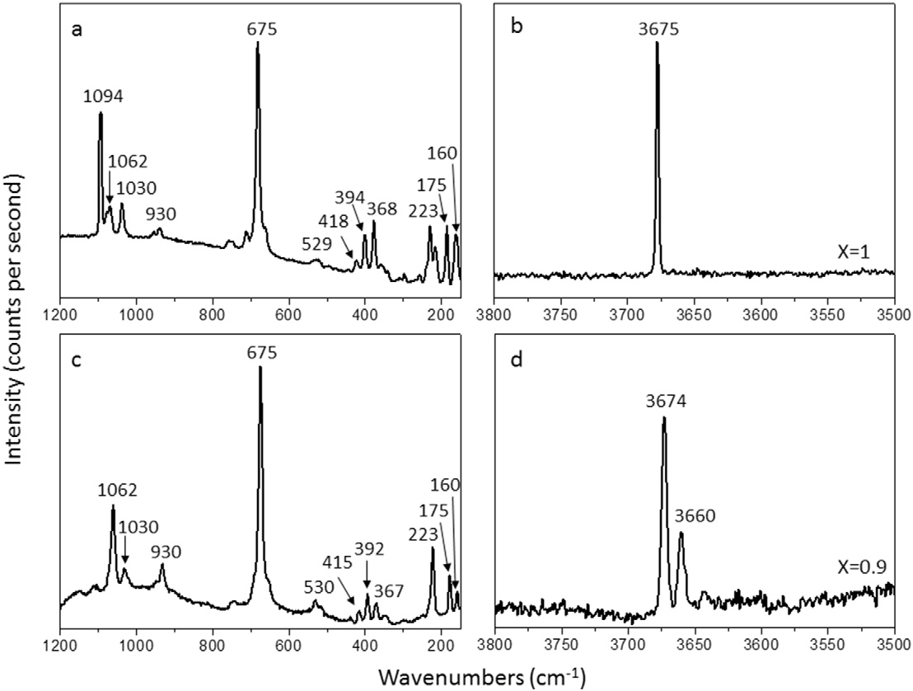
μ-Raman spectroscopy

Slide 13
Conclusions
μ-Raman spectroscopy and XRPD analysis were applied to the serpentinites rocks from the Pollino massif (southern Apennines, Italy).
These analysis allowed the recognition of lizardite, antigorite, chrysotile, polygonal serpentine and tremolite which are fibrous minerals considered potentially carcinogenic.
Among the different mineralogical analysis, μ-Raman spectroscopy is a very quick and safe technique because it requires acquisition times much lower than those needed for the XRPD
To study rocks containing hazardous minerals for the human health, the μ-Raman spectroscopy is preferable to XRPD because it is quicker, easier and safer. In fact the spectroscopic analysis can be performed directly on macroscopic samples avoiding all harmful rock treatment, such as crushing and pulverizing, which are mandatory for the XRPD analysis.

Slide 14
THANK YOU FOR THE ATTENTION

