Slide 1



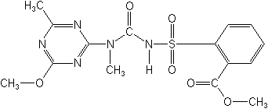
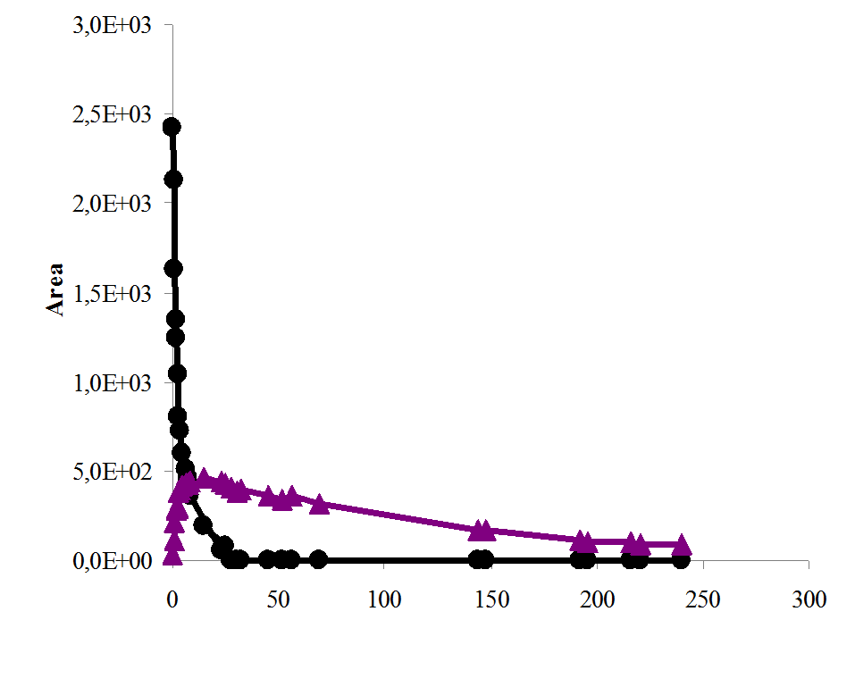
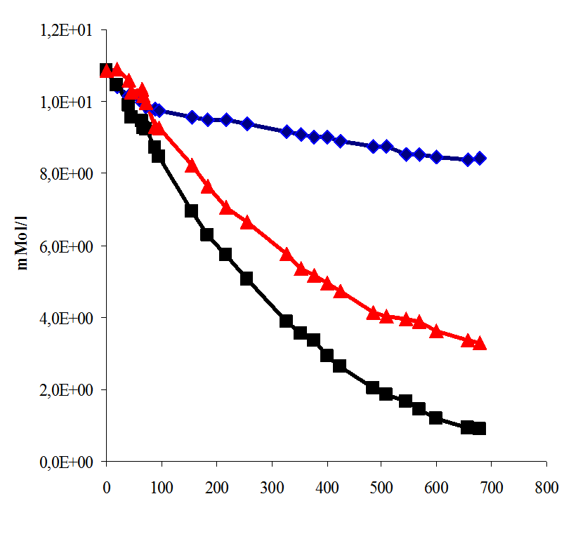
XXXVIII Convegno nazionale della Società Italiana di Chimica Agraria
20-21 settembre 2010, Piacenza
DEGRADAZIONE FOTOCHIMICA DI UNA SOLFONILUREA IN ACQUA DI FALDA
Laura Scrano¹*, Sara Chiola¹, Filomena Lelario¹, Achille Palma² e Sabino Aurelio Bufo¹
¹ Dipartimento di Scienze dei sistemi Colturali, forestali e dell’Ambiente, Università della Basilicata, Via dell’Ateneo Lucano 10,
85100 Potenza,
² Sezione di Chimica, Metapontum Agrobios, Metaponto
Introduzione
Il Tribenuron Metile, è un erbicida di nuova generazione appartenente alla famiglia delle solfoniluree. Il suo meccanismo d’azione consiste nell’inibire la divisione cellulare della pianta: in particolare inibisce l’azione dell’acetolattato sintasi, un enzima chiave nella sintesi degli amminoacidi ramificati [1,2]. Benchè tale solfonilurea sia adoperata in basse dosi (10–20 g/ha) [2,3], il suo uso intensivo provoca la contaminazione di acque superficiali e sotterranee grazie a fenomeni di percolamento e trasporto dal suolo alla fase liquida [4]. le colture agricole, sono soggetti a due tipi di degradazione: biotica ed abiotica. La prima avviene ad opera dei microrganismi, la seconda in seguito a reazioni di fotolisi, fotossidazione e di idrolisi. Poiché le reazioni abiotiche (tranne l’idrolisi) sono associate alla radiazione solare, la maggior parte delle reazioni di degradazione hanno luogo durante il giorno. here are several ways of natural degradation of sulfonylurea herbicides, for example, aqueous hydrolysis reactions, microbial processes (especially in soils) and photodegradation reactions [1,3].
The aim of this research was to know the behaviour of this herbicide in natural conditions. Then was studied the degradation of this herbicides, in the dark and under irradiation, in two liquid phases: in ultrapure water and in natural water sample.
Materials/Methods
Tribenuron-Methyl was purchased from Dr Ehrenstorfer GmbH (Augsburg, Germany).All solvents (pesticide grade), reagents (analytical grade) and filters (disposable sterilized packet) were purchased from Sigma-Aldrich (St. Louis, MO), and Fluka Chemie (Buchs, Switzerland). Ultrapure water was obtained by means of a Millipore (Billerica, MA) Milli-Q system.
The natural water was collected from a well sited into the rural area of Villa d’Agri in the Basilicata region (Southern Italy).
The solution of Tribenuron-Methyl (15 mg/l) were irradiated by using a solar simulator apparatus (Suntest CPS+, Heraeus), furnished of a Xenon lamp. Dark experiments were carried out in the same conditions of temperature and concentration. At selected times, samples were collected and analysed by HPLC and LC/MS.The behaviour of this herbicide in ultrapure water and in natural water samples was compared .
Table 2 . Kinetic parameters of Degradation in ultrapure and natural water
 | Acqua Ultrapura |  |  | Acqua di falda
 | K | t_{0,5} (h) | R² | K | t_{0,5}(h) | R²
Degradazione totale | 0,07 | 1,32 | 0,9999 | 0,0035 | 198,0421 | 0,9956
Idrolisi | 0,04 | 2,42 | 0,9999 | 0,0003 | 2310,491 | 0,9475
Fotolisi | ------ | ------ | ------ | 0,0019 | 364,8143 | 0,9922
Fig.1.Degradation in Ultrapure Water:
a) Tribenuron-Methyl
b) 2-methoxy-4-methylamino-6-methyl-1,3,5-triazine
a
Risultati e Discussione
During the Xenon-Suntest irradiation, the hydrolysis and photodegradation reactions coexist.
Therefore,the disappearance rate measured in the lighting conditions is due to the sum of both phenomena.
For estimating the exclusive contribution of the light on the herbicide disappearance, the quantity (C0-Ct) disappeared at the time “t” during the reaction in the dark was added to the quantity Ct of the herbicide remained during the simulated solar irradiation at the same reaction time.
Both the hydrolysis and photolysis reaction of Tribenuron-methyl were faster in ultrapure water respect the natural water (table 1)
The main metabolite identified in the ultrapure water solutions during the first 10h of irradiation and in the natural water after 88h was 2-methoxy-4-methylamino-6-methyl-1,3,5-triazine (m/z 155)
Conclusioni
The results obtained showed that the degradation rate of the herbicide could be strongly influenced by the water quality (figure 1 and 2).
The investigation also stressed the importance of light exposure on the degradation rate of Tribenuron-methyl. Photolysis of this herbicides, in natural conditions, can be a very important process but is not an efficient method of detoxification because the degradation product (that is toxic as your origin substance) persist a long time in the environment.
b
Fig.2 Degradation in Natural Water:
■ Total degradation
♦Hydrolysis
▲Only Photolysis
Time (h)
Time (h)
References
[1] B. Michela, M. C. Gennaro; American Society for Mass Spectrometry 19 (2008) 1221-1229
[2] S. Polati, M. C. Gennaro; Analytica Chimica Acta 579 (2006) 146-151
[3] M. J. Sanchez-Martin, M. S Rodriguez-Cruz, M. S. Andrades, M. Sanchez-Camazano; Applied Clay Science 31 (2006) 216-228
[4] R. Zhu, J. Zhu, F. Ge, P. Yuan; Journal of Environmental Management 90 (2009) 3212-3216

