Slide 1



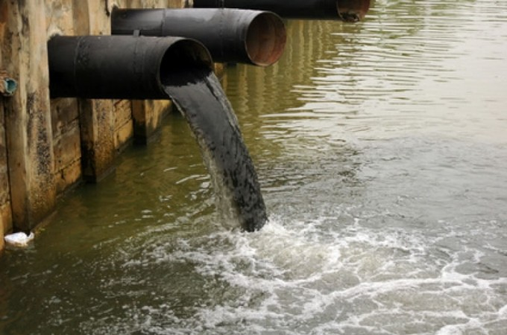
ª Nº is the number used to identify each drug in the chromatograms of Figure 1. ^{b} Mass error in part per million, ppm=10⁶ * (accurate mass-exact mass)/exact mass.
DETERMINATION OF PHARMACEUTICALS’ RESIDUES IN WASTEWATER OBTAINED WITH AN OPTIMIZED LC-FTICR MS METHOD
F. Lelario¹, L. Scrano², S.A. Bufo¹
^{1, 2} Department of Science, University of Basilicata, Potenza, Italy, ²Department of European Culture, University of Basilicata, Matera, Italy,
PROBLEM. Many pharmaceuticals (PhCs) are considered as emerging contaminants [1] introduced anthropogenically in the environment through industry or domestic wastewater [2]. PhCs have been detected at parts per million and parts per trillion concentrations in surface waters suggesting an inefficient removal of these compounds by conventional sewage treatment processes. Recycled water, especially in arid and semi-arid regions, is a reliable source of water that must be taken into account in formulating a sustainable water policy. The recycling of treated wastewater for agricultural purposes allows the reuse of water resources.
AIM. In this article we focused on the development of an analytical multi-residual method, by using LC-FT/ICR-MS, for a particular class of pharmaceuticals, chosen according to previous studies carried out on the industrial site located in Basilicata region, where wastewater is reused for the irrigation of an experimental olive field. The optimized method was applied to samples collected in the influent and the effluent from the monitored wastewater treatment plant in order to know more about the presence of pharmaceuticals in this reused wastewater
Pharmaceuticals studied were:
metformin hydrochloride, amoxicillin,
clarithromycin, erythromycin,
caffeine,
carbamazepine, naproxen,
aspirin,
ibuprofen,
diclofenac sodium.
Instrumentation: Surveyor LC system coupled to a FTICR mass spectrometer (Thermo Fisher Scientific, Bremen, Germany), equipped with a 20 W CO₂-laser (Synrad, Mukilteo, WA, USA; 10.6 μm)., USA).
Ions observed for drugs in positive and negative mode by high resolution LC-ESI-FTICR MS.
Extracted ion chromatograms (XICs) by LC/ESI-FTICRMS acquired in positive or negative ion mode of sample of wastewater influents. The ions monitored are displayed in each trace and correspond to the most abundant protonated or deprotonated molecules, [M+H]⁺ or [M-H] ⁻, using a restricted window of ±0.0010 m/z unit centred around each selected ion. Data acquisition was made on a LTQ-FT hybrid linear trap/ICR mass spectrometer equipped with a 7-T magnet. Peak numbers correspond to
(1) metformin hydrochloride, (3) caffeine,
(5) clarithromycin,
(6) carbamazepine,
(8) diclofenac,
(10) aspirin.
Nº | name | mode | Formula Corresponding ion | m/z calculated | m/z observed | Mass error (ppm)^{b}
1 | Metformin hydrochloride | (+) | C₄H₁₂N₅⁺ | 130.10872 | 130.10860 | -0.92
2 | Amoxicillin | (+) | C₁₆H₂₀N₃O₅S⁺ | 366.11182 | 366.11179 | -0.08
3 | Caffeine | (+) | C₈H₁₁N₄O₂⁺ | 195.08765 | 195.08755 | -0.51
4 | Erythromycin | (+) | C₃₇H₆₈NO₁₃⁺ | 734.46852 | 734.46765 | -1.18
5 | Clarithromycin | (+) | C₃₈H₇₀NO₁₃⁺ | 748.48417 | 748.48395 | -0.29
6 | Carbamazepine | (+) | C₁₅H₁₃N₂O⁺ | 237.10227 | 237.10210 | -0.72
7 | Naproxen | (+) | C₁₄H₁₅O₃⁺ | 231.10154 | 231.10149 | -0.22
8 | Diclofenac | (-) | C₁₄H₁₀NOCl₂⁻ | 294.00941 | 294.00937 | -0.14
9 | Ibuprofen | (-) | C₁₃H₁₇O₂⁻ | 205.12340 | 205.12347 | 0.34
10 | Aspirin | (+) | C₉H₉O₄⁺ | 181.04954 | 181.04947 | -0.39
ª Nº is the number used to identify each drug in the chromatograms of Figure 1. ^{b} Mass error in part per million, ppm=10⁶ * (accurate mass-exact mass)/exact mass.
H
O
O
N
O
Conclusion
Using a very selective method based on ESI-LTQ-FTICR-MS, we have demonstrated that it is possible to analyze pharmaceuticals compounds in raw and treated wastewater with high sensitivity and very good mass accuracy. In particular, the results of this study show that the adapted analytical methodology employed was effective for monitoring pharmaceutical products in influent and effluent streams of wastewater treatment plants. This method, coupled with a statistical survey conducted with doctors and pharmacies of the study area, reduced the analytical effort necessary to cover a wide range of compounds with different natures, and still achieved good LOD and LOQ levels, with high recoveries in influent wastewater. Among the PhCs considered in this study, only carbamazepine and clarithromycin were found in the effluent of the tertiary pilot WWTP, which have been used for 10 years for the irrigation of an experimental field of olive trees.
S
H
N
O
O
H
H
H
2
N
(A) MS spectrum at the apex of the chromatographic peak 2, i.e. amoxicillin, at m/z 366 (see Fig. 1). (B) High-resolution IRMPD FTICR mass spectrum of the protonated amoxicillin at m/z 366
1)Cahill JD, Furlong ET, Brukhardt MR, Kolpin D, LG. A (2004) J Chromatogr A 1042:171–180, 2) Farre M, Ferrer I, Ginebreda A, Figueras M, Olivella L, Tirapu L, Vilanova M, Barcelo D (2001) J Chromatogr A 938:187–197

